Slide 1

Beth Chaney
Associate Commissioner
Office of Budget
A Path to Improve Customer Service Today and into the Future
March 2024

Slide 2
Staffing Declines As Beneficiaries Rise
Field Office Attrition 10% 1-800 Staff Attrition 22%

Slide 3
Administrative Funding Declining as % of Benefit Outlays

Slide 4
Where we are now (through February):
Wait Time on our 1-800 Number
38 minutes
Wait Time for an Initial Disability /Reconsideration Decision
228 days/223 days
Wait Time for a Hearing Decision
365 days

Slide 5



We are still far more efficient than private insurance companies in admin expenses

Slide 6
Customer Service Outcomes with Funding at 1.2% of Benefit Outlays
Where we are now (FYTD Feb.):
Where we can go (long-term goals):
Wait Time on our 1-800 Number
38 minutes
Wait Time on our 1-800 Number
5 minutes
1.2%
Wait Time for an Initial Disability /Reconsideration Decision
228 days/223 days
Wait Time for an Initial Disability /Reconsideration Decision
120 days/120 days
1.2%
Wait Time for a Hearing Decision
365 days
Wait Time for a Hearing Decision
270 days
1.2%

Slide 7
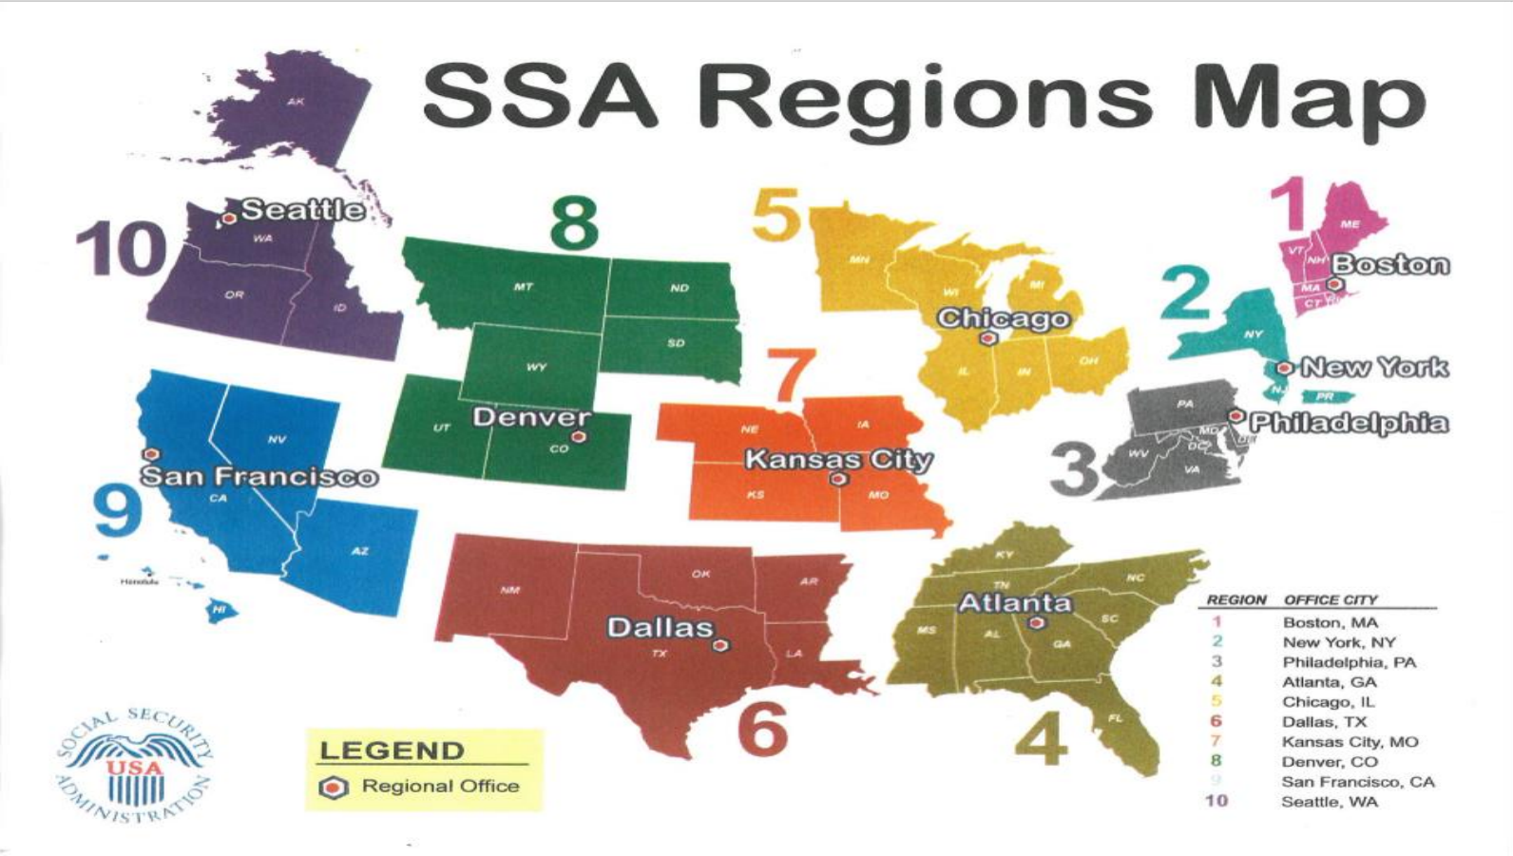

Driving Change, Leading from the Front Lines
Announced a plan to increase our onsite presence beginning
in April.
Hired new Chief Operating Officer, Chief Information Officer,
and General Counsel.
Conducted 10 town halls throughout the country; over 2,000
employees present.
Launched SecuritySTAT on February 5 – a cross-cutting performance management program – to
accelerate the deployment of a host of customer service improvements.

